Slide 1
Quarto templates
Olivia Box Power, Annabel Westermann, Kate Hutchinson
Published 23/11/2023

Slide 2
Aims
Earlier in the year several teams in OHID wanted to create reproducible HTML reports with either OHID or GOV.UK branding.
We didn’t want analysts to have to spend time styling documents.
We decided to explore the use of Quarto templates to solve this issue.

Slide 3

What is Quarto?
An open-source scientific and technical publishing system.
It can be used to create reproducible documents (HTML, word, pdf) , articles, websites, presentations, dashboards and books.
Quarto is the next generation of R Markdown. Most R Markdown files can be rendered by quarto by changing the file extension from .rmd to .qmd.
The latest versions of Rstudio include quarto, so no need to install further software.

Slide 4
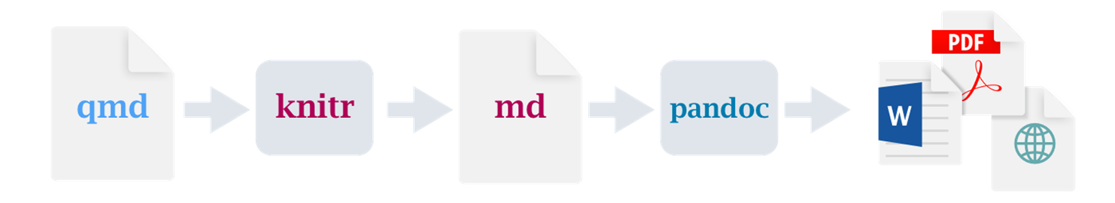
How does quarto work
A .qmd file contains markdown formatted text and chunks of code (in R, python etc).
When you render the file, the code is executed to produce a markdown file (.md) containing all the text and the code output. This is then passed to pandoc, which converts it into the final document.

Slide 5
Differences between Quarto and R Markdown
Quarto is very similar to R Markdown. Quarto can process most R Markdown files. However, it has the following advantages:
Quarto is NOT an R package. It can be used with multiple languages (e.g. python).
Quarto has multiple engines for running code. It is not limited to using the Knitr R package. Therefore, if can be used to run python code in other IDEs (e.g. VS Code) and Jupyter notebooks, without using Knitr.
Specialist outputs (e.g. books, blogs, websites) don’t require additional R packages.

Slide 6
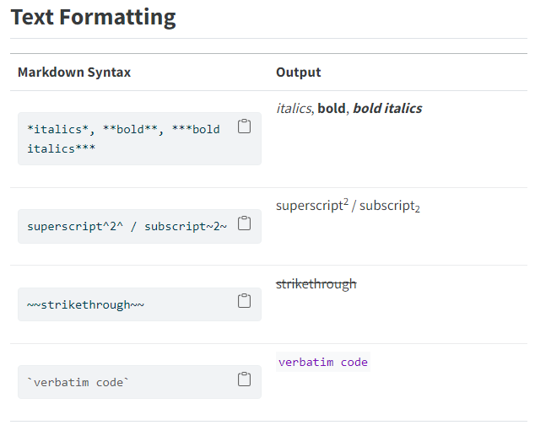
Markdown Syntax
https://quarto.org/docs/authoring/markdown-basics.html

Slide 7
Quarto custom templates
Quarto extensions can be used to add additional features.
One type of extension is a ‘custom format’, which based on one of the existing base formats (e.g. pdf, HTML)

Slide 8
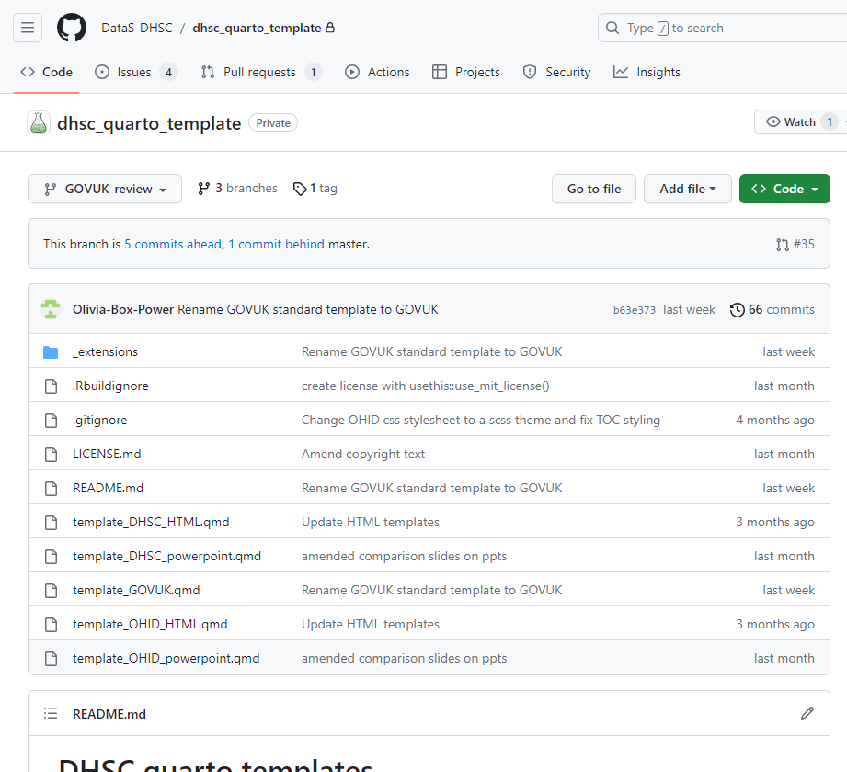
Github

Slide 9
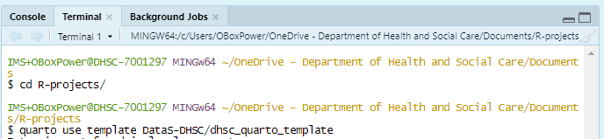
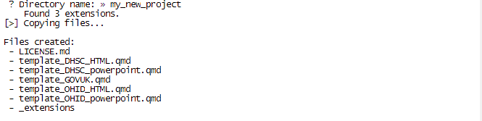
How to use the templates

Slide 10
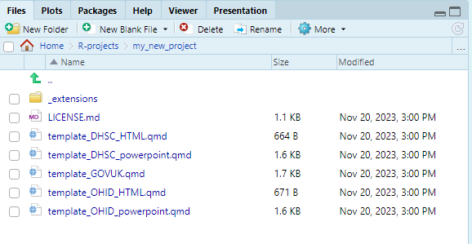
How to use the extensions
Do not edit this folder
Edit one of these template files

Slide 11
DHSC templates
PowerPoint with DHSC or OHID branding
HTML document with DHSC or OHID branding
HTML document with GovUK style branding

Slide 12
DHSC and OHID Templates Demo

Slide 13
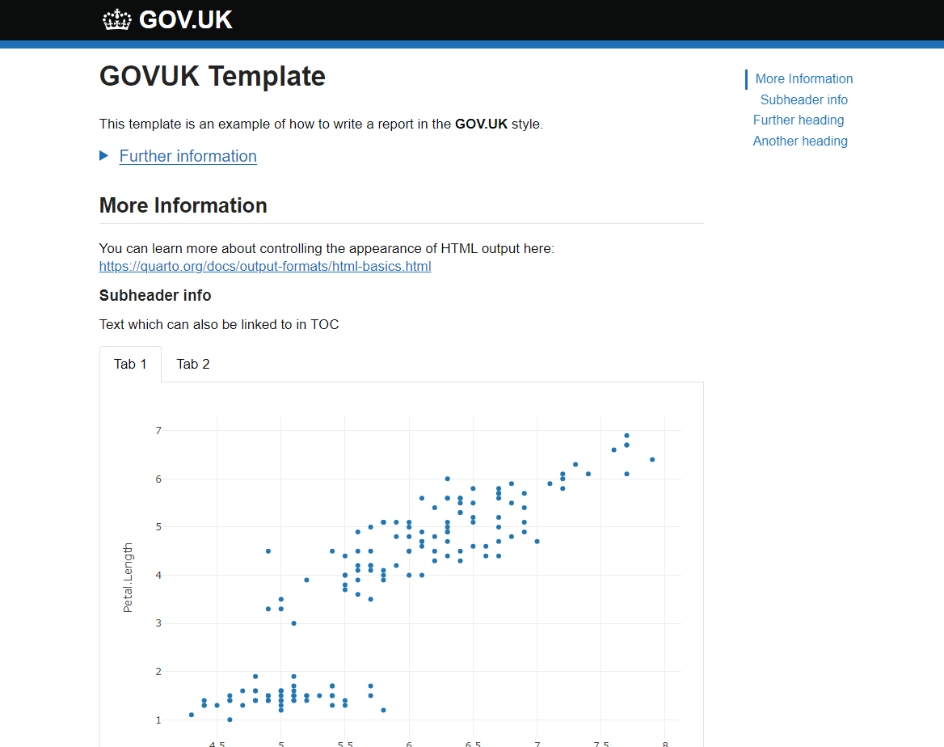
GOV.UK Templates Demo

Slide 14
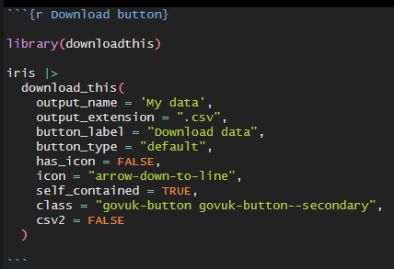
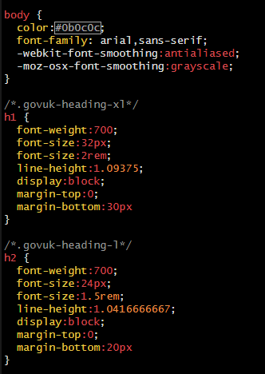
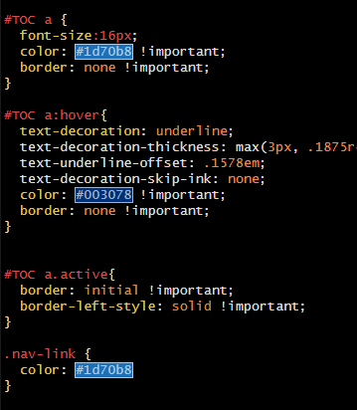
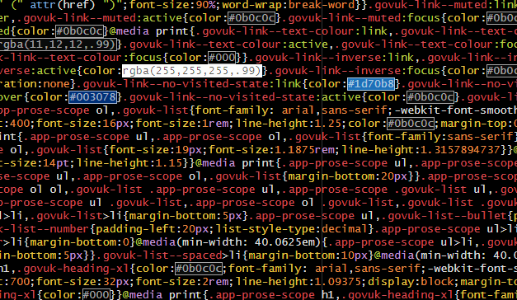
CSS
Used GOV.UK CSS style sheet directly for some components
Need to write out own style sheet for Quarto components (i.e. tabs, headers, TOCs) as Quarto assigns different ids/classes, and copy CSS from GOV.UK style sheet into a new SCSS theme and link that in the YAML – this needs to be maintained

Slide 15
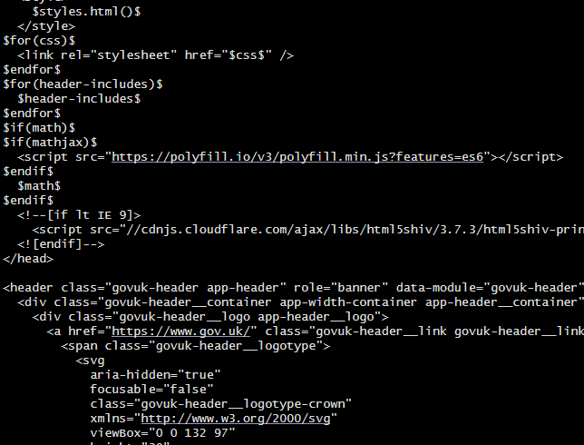
Inserting HTML components into Quarto Pandoc template
Quarto pages are generated from a Pandoc template file
We inserted GOV.UK style header and footer into the default Quarto Pandoc template
(Variables are surrounded by $ signs)
https://quarto.org/docs/journals/templates.html

Slide 16
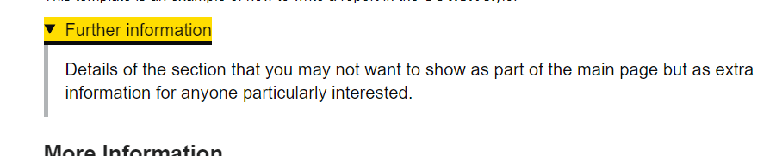
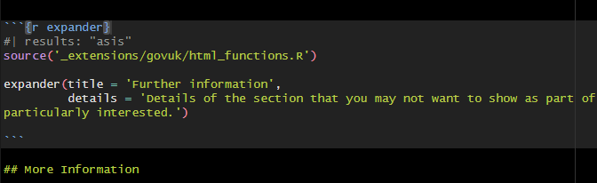
New R functions to make GOV.UK style components
To make the GOV.UK style components, we have provided R functions to create the HTML

Slide 17
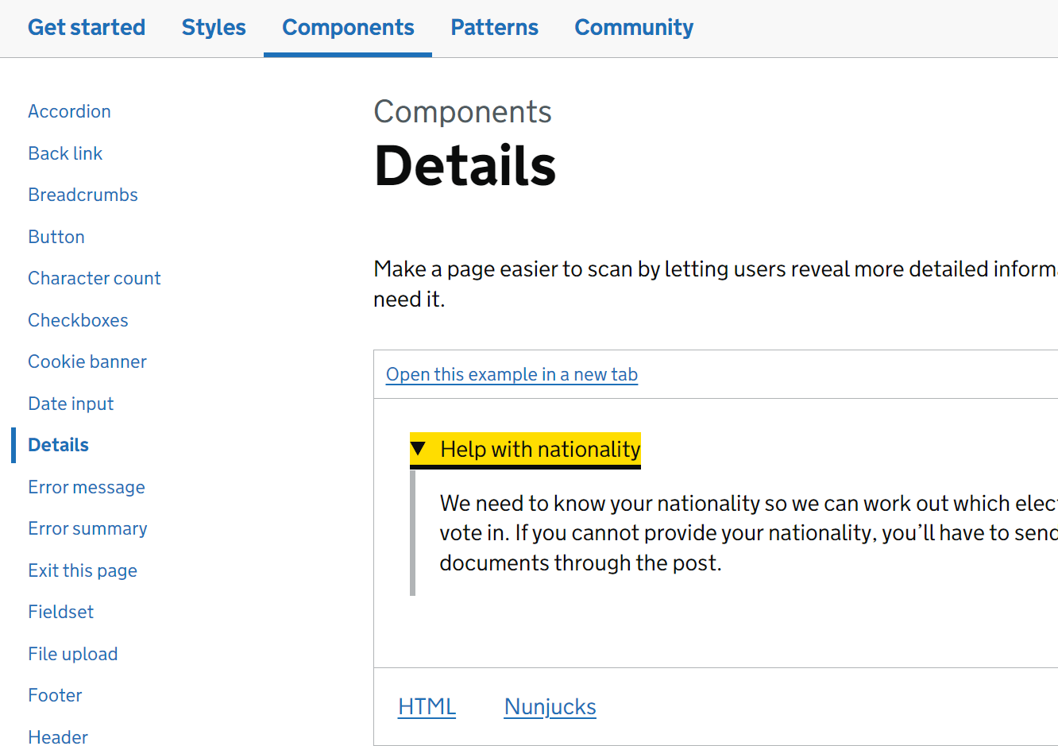
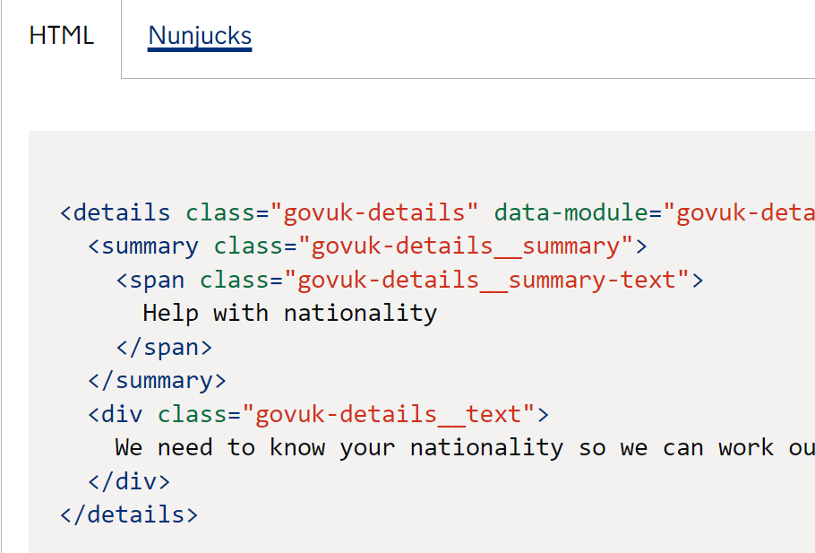
Using components from GOV.UK Design System

Slide 18
Future developments
More components
Add requests to the repo's GitHub issues
Python version of templates

